Slide 1




DIGITAL LITERACY
SKILLS
INTERMEDIATE USERS

Slide 2
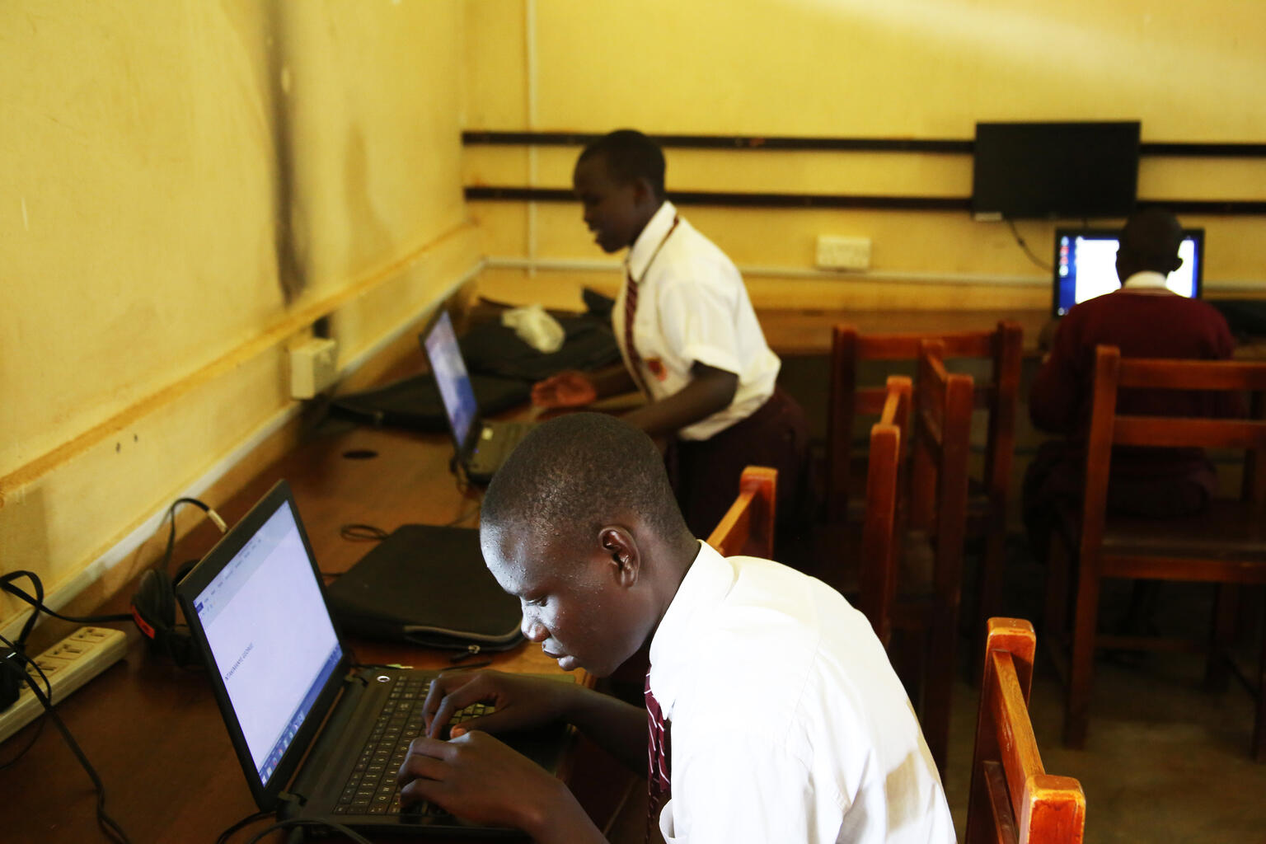
Module 6
Problem solving

Slide 3

1
Unit 1: Solving technical problems

Slide 4
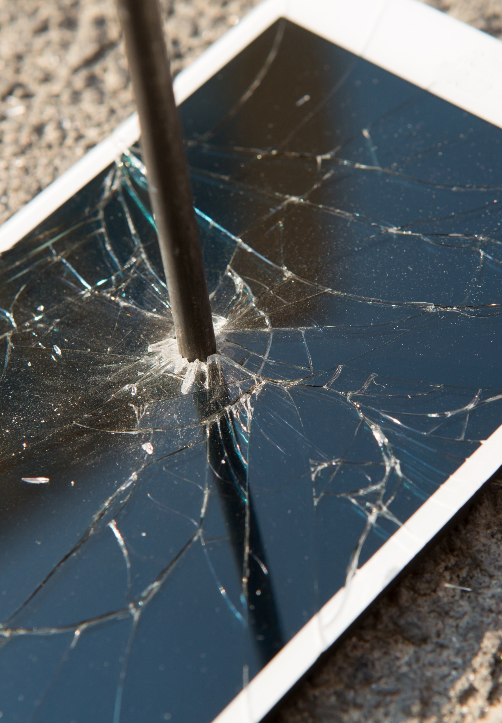
Most common technical problems
The computer won’t start
The screen is blank
Abnormally functioning operating system or software
Windows won’t boot
The screen is frozen
A program on the computer is frozen
Computer is slow
Storage space
Continue >

Slide 5
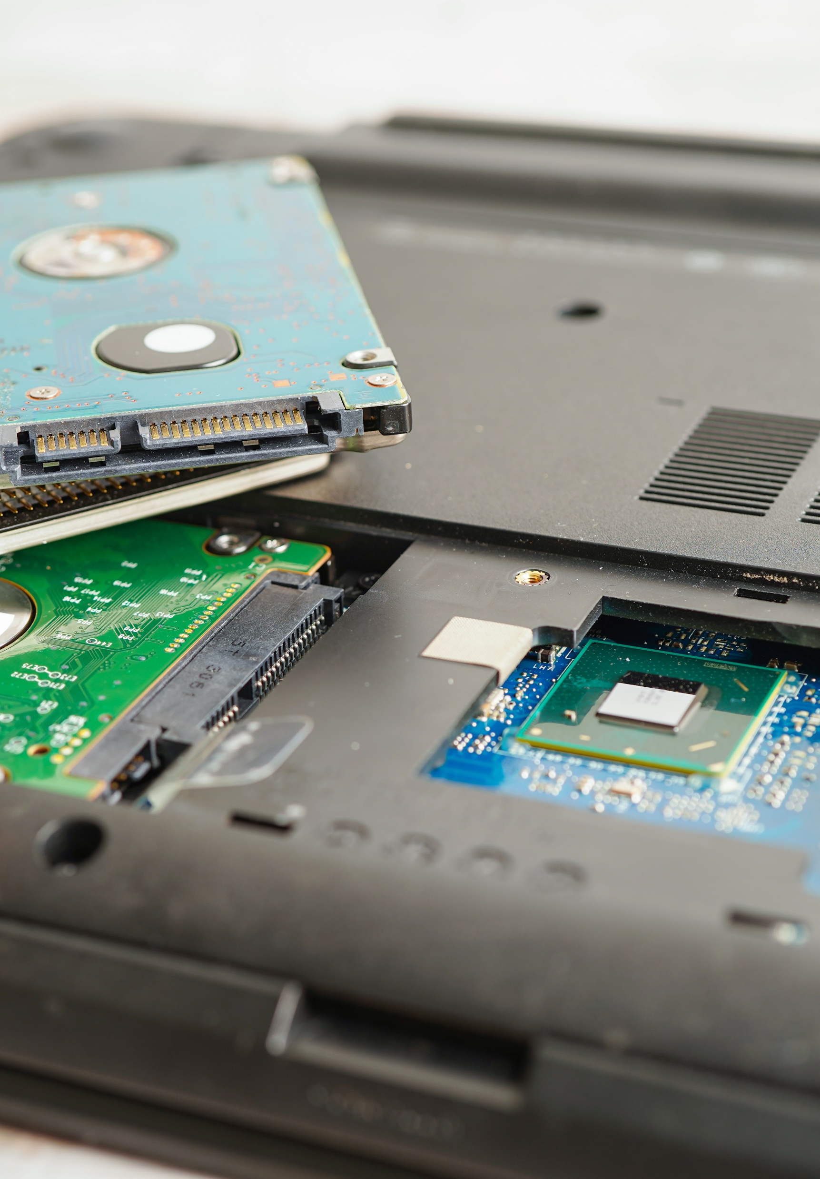
Most common technical problems
Dropped internet connections
Strange noises
Computer overheating
Slow internet
Smartphone is running slowly
Phone or app crashes
Smartphone overheating
Continue >

Slide 6
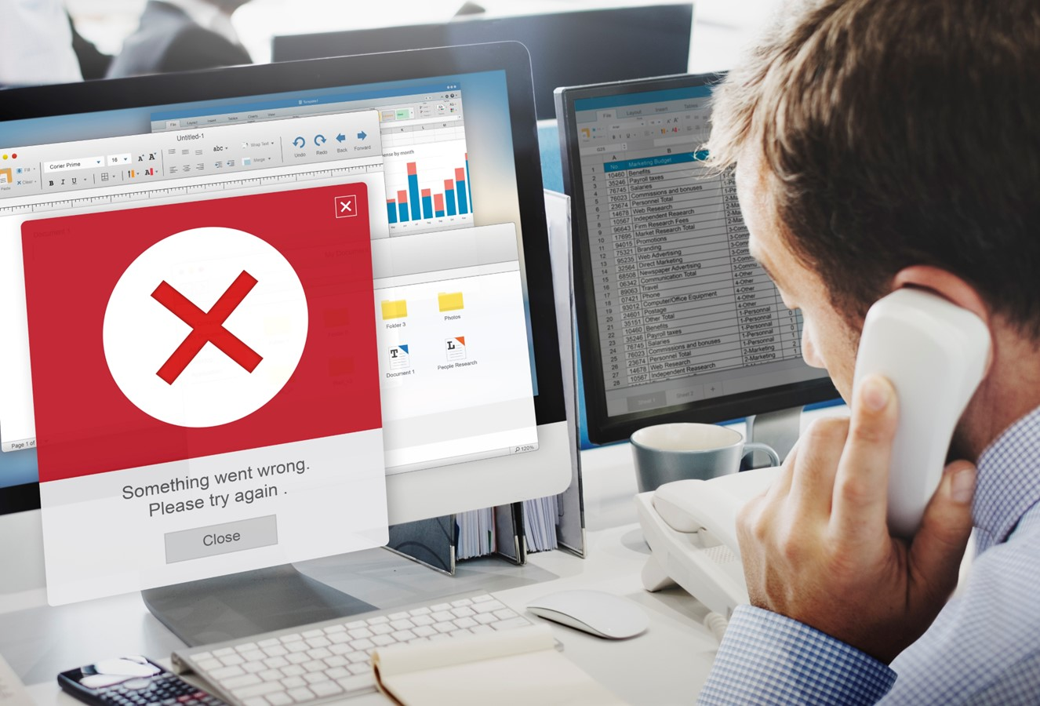
Most common technical problems
Problems connecting with Bluetooth, Wi-Fi, cellular network
Apps not downloading
Synchronization (sync) issue
Cracked screen or immersion in water

Slide 7
Skills to practise
Solve common problems
Create a separate list for each type of device that you use.
For each device, list the trouble shooting steps that you will go through when you encounter a problem.
Search the internet and list websites you can visit that can help you solve unexpected problems you are not familiar with.
Complete research in your local community and list people or businesses the offer repair or technical support services.

Slide 8
All back covers should include
contact information of the section
producing the work.
© United Nations Children’s Fund (UNICEF) [month and year of publication]

